Slide 1
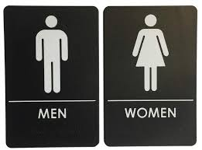
ENTREPRENEUR VALUES, PREFERENCES, AND MOTIVES: A PERSON-ENTREPRENEURSHIP FIT PERSPECTIVE
MOTIVES GENDER
Self-realization
Financial success
Roles
Innovation
Recognition
Independence
Schwartz’s Circular Motivational Continuum of Values. The circular structure of ten basic values, four higher order values, and two underlying motivational sources. (published with permission, Schwartz & Sortheix, 2018, as adapted from Schwartz, 2015; http://nobascholar.com/)

