Slide 1
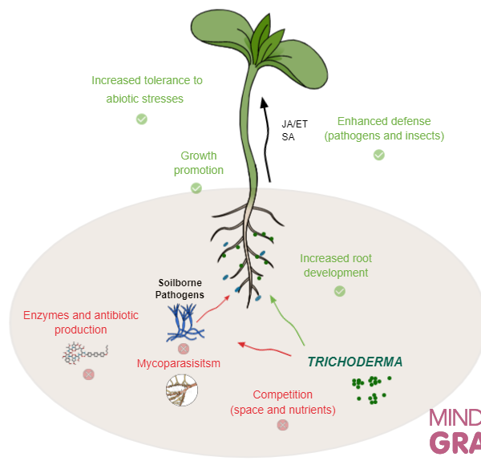
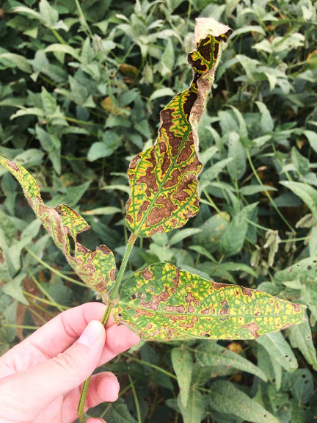
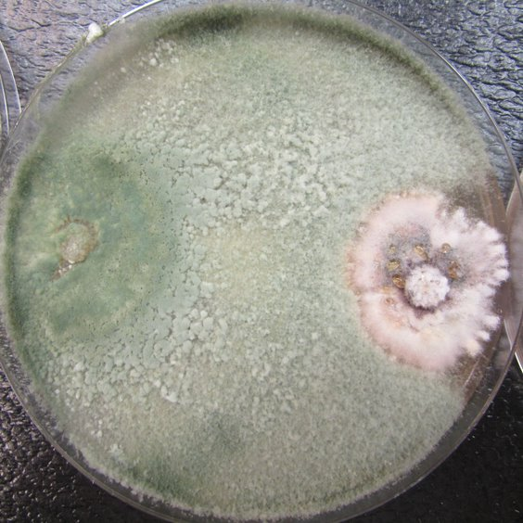
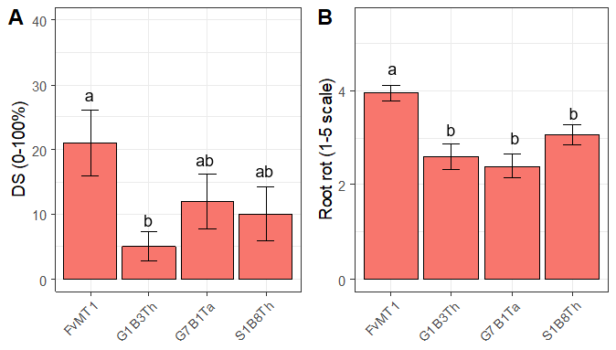
Biocontrol Agents
A Potential Tool For Disease Management
Plant pathogens: diseases and losses
Soybean: 10% production is lost yearly! (Mueller, 2016)
Biological
Control
Fusarium spp.
Pythium spp.
Biocontrol as a potential tool for disease management in soybean supported by data
Pimentel, M. F. 2020
Research founding: NCSRP, USB

