Slide 1


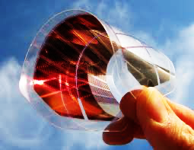
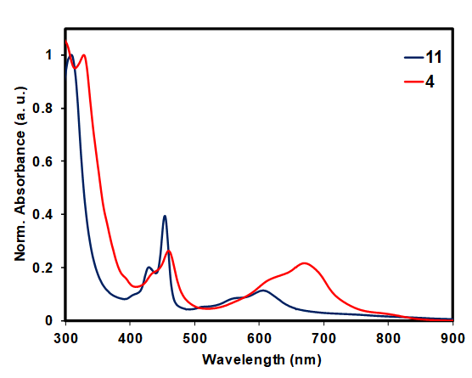
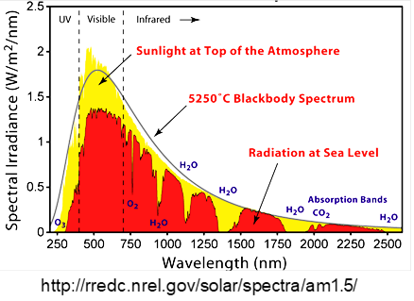
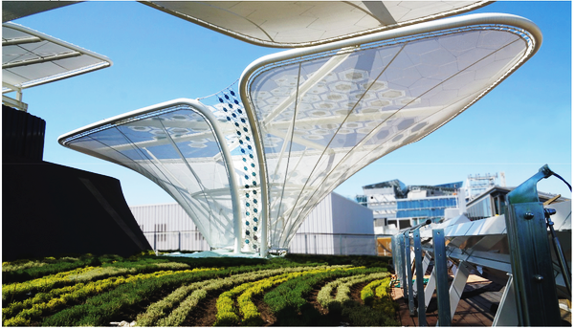
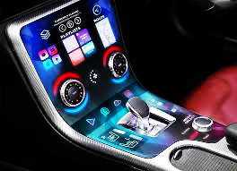
Anthradithiophene (ADT) Based Organic Semiconductors
Flexible Electronics
New ADT Materials
Absorption
Pentacene
ADT
Organic Solar Cells | Si-based Solar Cells
Light weight | Heavy
Inexpensive | Expensive
Flexible | Rigid
Tunable | Non tunable
Eco-friendly | Non eco-friendly
Waseem Hussain

