Slide 1
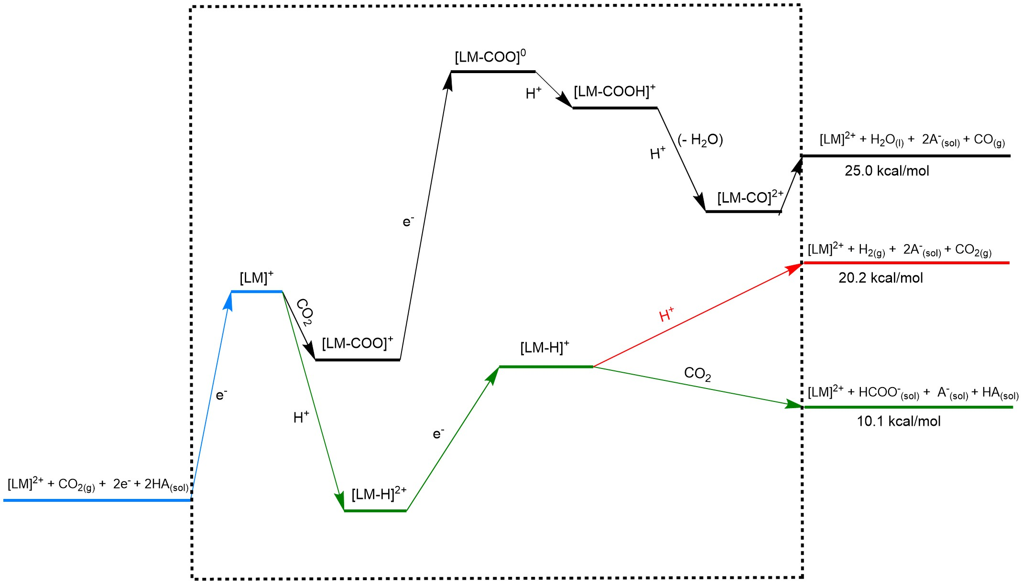
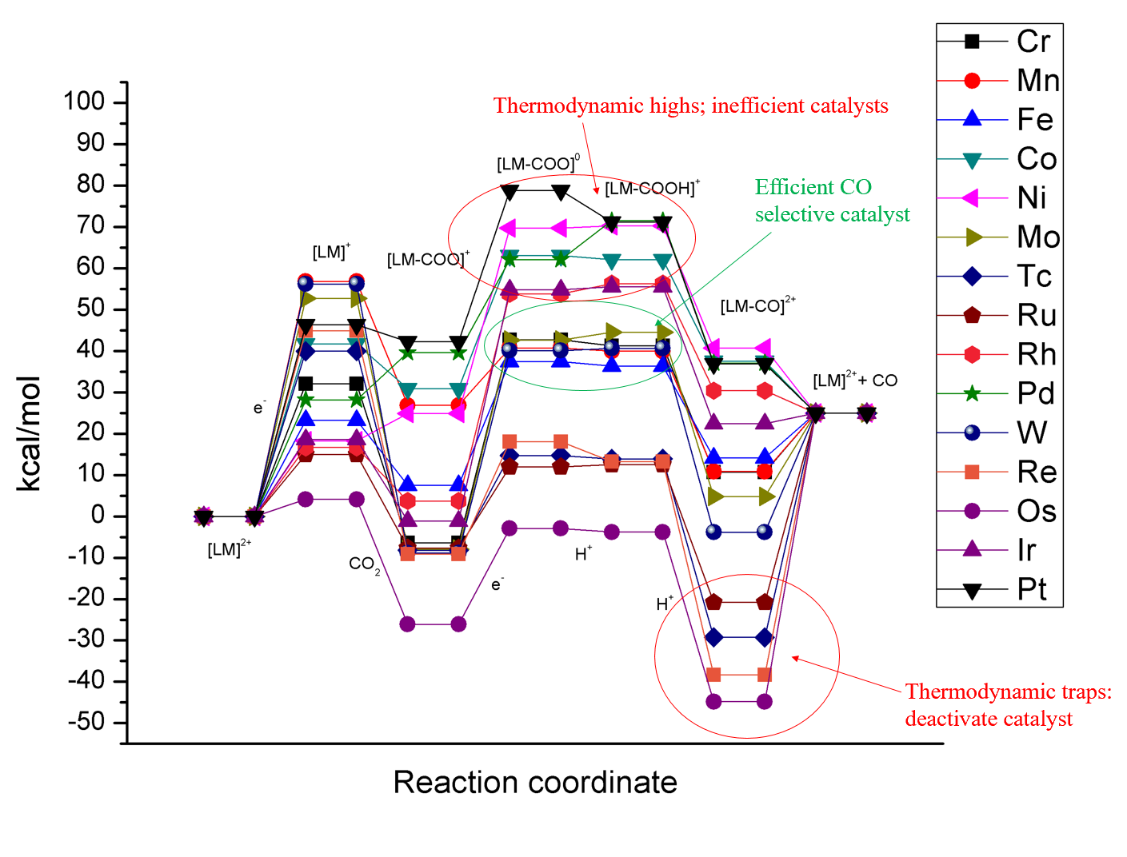
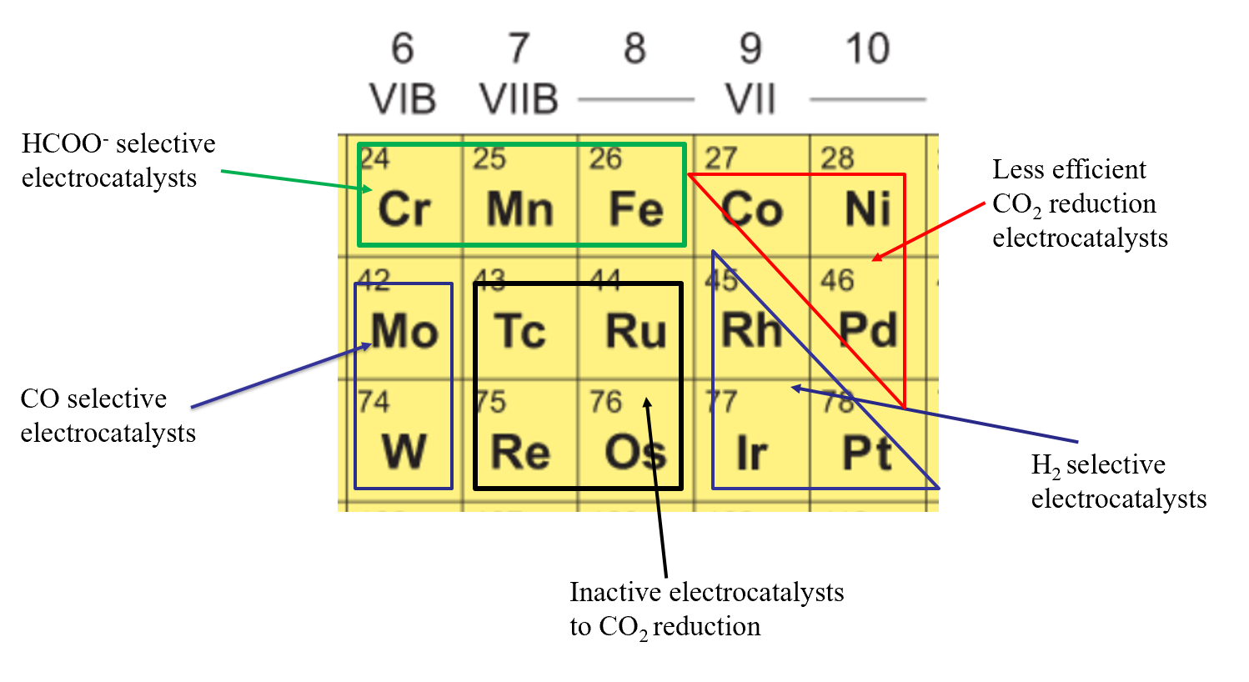
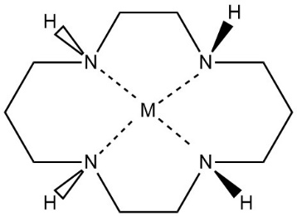
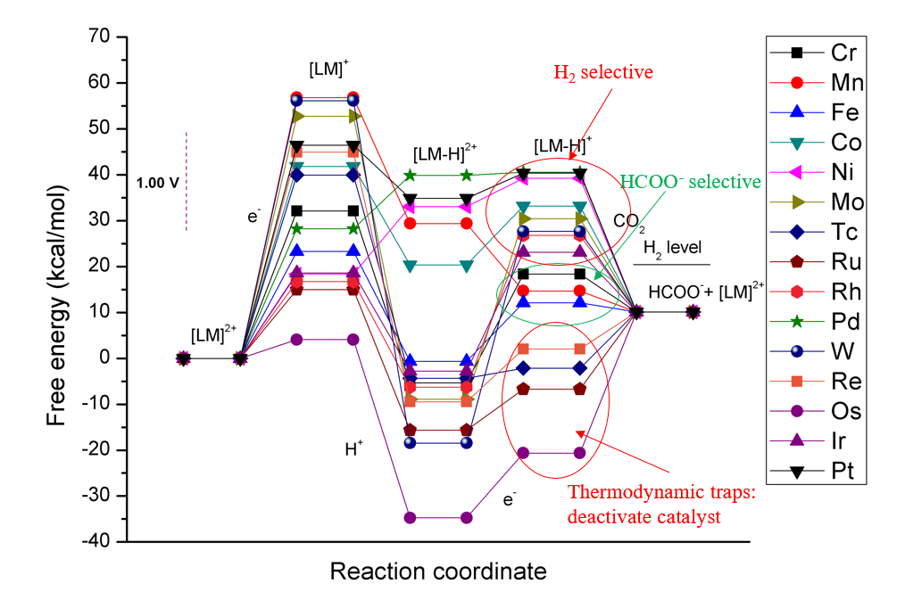
A systematic computational screening for efficient and selective cyclam based molecular catalysts for CO2 electrochemical reduction
Zaheer Masood and Qingfeng Ge
Department of Chemistry & Biochemistry, Southern Illinois University, Carbondale, IL 62901
Abstract
Recycling CO₂ from industrial emission and capturing it back to carbon cycle through conversion into value-added chemical can provide dual purpose of mitigating green house effect and reducing consumption of fossil fuels. We investigated computationally energy efficient and selective catalysts for reduction of CO₂ to either CO or HCOO⁻. We examined the electrochemical reduction of CO₂ to CO and HCOO⁻ with a cyclam based molecular catalysts with Cr, Mn, Fe, Co, Ni, Mo, Tc, Ru, Rh, Pd, W, Re, Os, Ir and Pt as metal centers in an aqueous medium. Our results show that Cr, Mn and Fe being the metal center are HCOO⁻ selective; Mo, W are CO selective; Rh, Ir, Pt are H₂ selective and rest of metal centers are inefficient electrocatalyst.
CO₂ released from combustion of fossil fuels contributes to the global warming climate anomalies and poses a threat to the humanity. Thus, electrochemical reduction of CO₂ to fuel and other commodities driven by renewable electricity promises to be a sustainable means to mitigate increasing CO₂ level and lessening dependence on exhaustible fossil fuels^{[1]}. Electrochemical reduction of CO₂ can produce HCOO⁻ and CO The HCOO⁻ can be used directly as chemical commodity and CO can be further hydrogenated to produce methane, methanol and ethylene which can be used direct as a fuel. Without catalyst, direct electrochemical reduction by transferring one electron to CO₂ has a thermodynamic overpotential of -1.9 V (vs. SHE)^{[2]} which demands high energy input. Therefore, a catalyst is needed to facilitate CO₂ reduction to lower energy input.
Computational tools identify a direction in research where performing experiments call for time and cost. Here Thus, we offer exhaustive computational screening for energy efficient and selective electrocatalysts for reduction of CO₂ to CO and HCOO⁻. Cyclam complexes are expected to be active for electrochemical reduction of CO₂ but only Ni cyclam have been tested ^{[3]} and many other metal centers in cyclam are still unexplored. The typical structure of cyclam isomer is shown in Fig. 1. Herein, we mapped out the pathways of CO₂ electrochemical reduction over the Cr, Mn, Fe, Co, Ni, Mo, Tc, Ru, Rh, Pd, W, Re, Os, Ir and Pt metal centers in cyclam and determined their selectivity towards CO₂ reduction. In water, proton reduction (resulting in H₂ evolution) competes with CO₂ reduction and included in this study.
Introduction
Scheme 1. Electrocatalytic paths in CO₂ electrochemical reduction to CO, HCOO⁻ and H₂ at cyclam based catalysts (L =cyclam and M = metal center). Red arrow shows path for H₂ evolution, black arrows show CO cycle, green arrows show HCOO⁻ cycle and blue arrow shows common path among HCOO⁻, H₂ and CO cycle.
Results and discussion
Figure 3. CO selective cycle on all electrocatalysts. Thermodynamic traps and highs are shown in red. And energy efficient cycles are shown in green
Scheme 1: catalytic path and possible intermediates for CO, HCOO⁻ and H₂, selective cycle
A catalytic path with flat or slightly upward landscape is energetically favorable.
Poor catalytic efficiency is result of either formation of very high energy intermediates (very highs in catalytic cycle).
Catalytic cycle with low energy intermediates show poor activity by creating thermodynamic traps and preventing further catalytic activity.
In this study, highs and thermodynamic traps are highlighted in catalytic cycle of for CO and HCOO⁻ in Figure 2 and 3.
Figure 2: catalytic path for CO₂ reduction to HCOO⁻ for all catalyst.
Figure 3: catalytic path of CO₂ reduction to CO for all catalyst.
Conclusions
Figure 1. Trans III cyclam conformation used in this study with 2+ oxidation state of catalyst (M= Cr, Mn, Fe, Co, Ni, Mo, Tc, Ru, Rh, Pd, W, Re, Os, Ir and Pt as metal centers in.
Methodology
Density Functional Theory (DFT) (Gaussian 16)
For geometry optimization and frequency calculations
Functional ; B3LYP
Basis set for non-metallic atoms: 6-31G (d, p)
Basis set for metallic atoms : ECP (SDD)
SMD solvation model in water for all calculations
Scheme 1 was used for catalytic cycle for CO, HCOO⁻ and H₂
References:
[1] Z. W. Seh, J. Kibsgaard, C. F. Dickens, I. Chorkendorff, J. K. Nørskov, T. F. Jaramillo, Science 2017, 355, eaad4998.
[2] P. Wardman, Journal of Physical and Chemical Reference Data 1989, 18, 1637-1755.
[3] G. B. Balazs, F. C. Anson, Journal of Electroanalytical Chemistry 1992, 322, 325-345.
Figure 2. Hydride cycle for all electrocatalysts. HCOO⁻ and H₂ share hydride cycle except last reaction. Thermodynamic traps and highs are shown in red. In hydride cycle, thermodynamic highs produce H₂.

