Slide 1
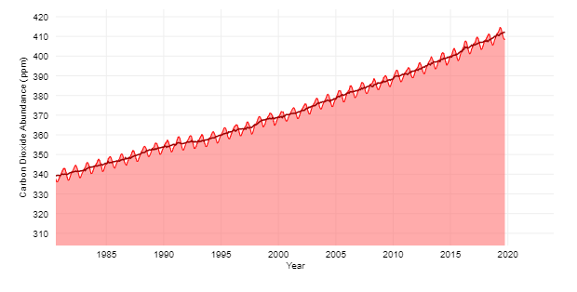
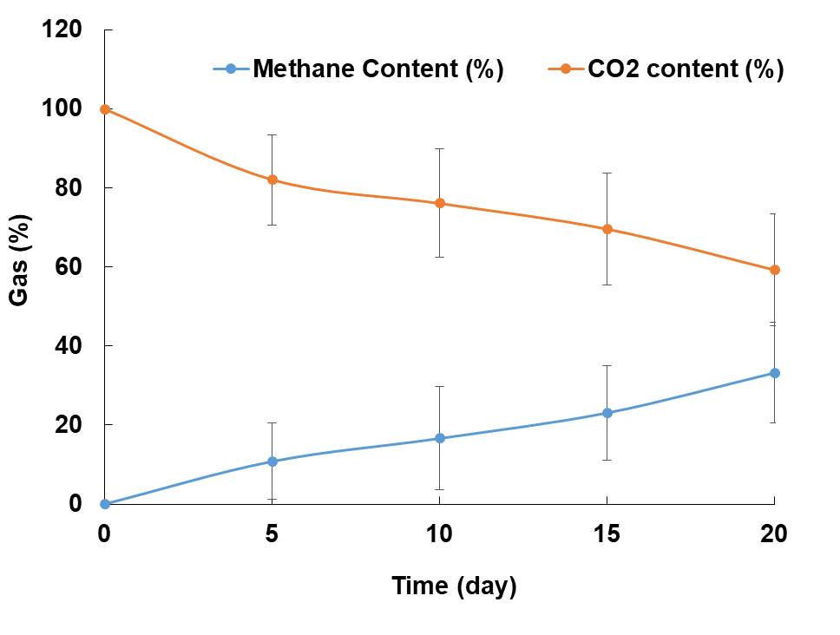
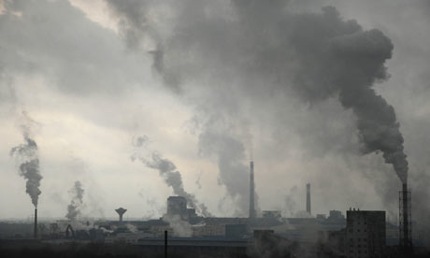
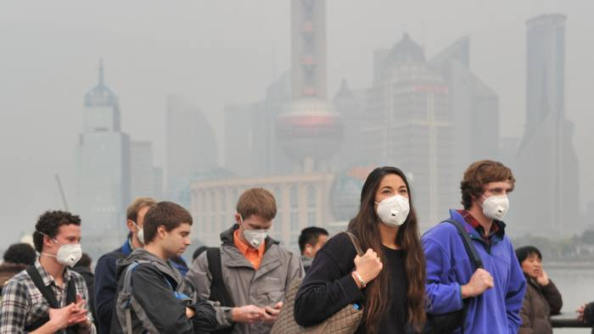
Problem*
Proposed Solution
Test the Idea
https://www.climate.gov/news-features/understanding-climate/climate-change-atmospheric-carbon-dioxide
Microbial electrochemical cell (MEC) for methane production from carbon dioxide utilizing microbes

