Slide 1
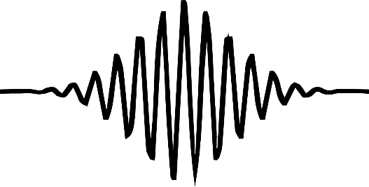
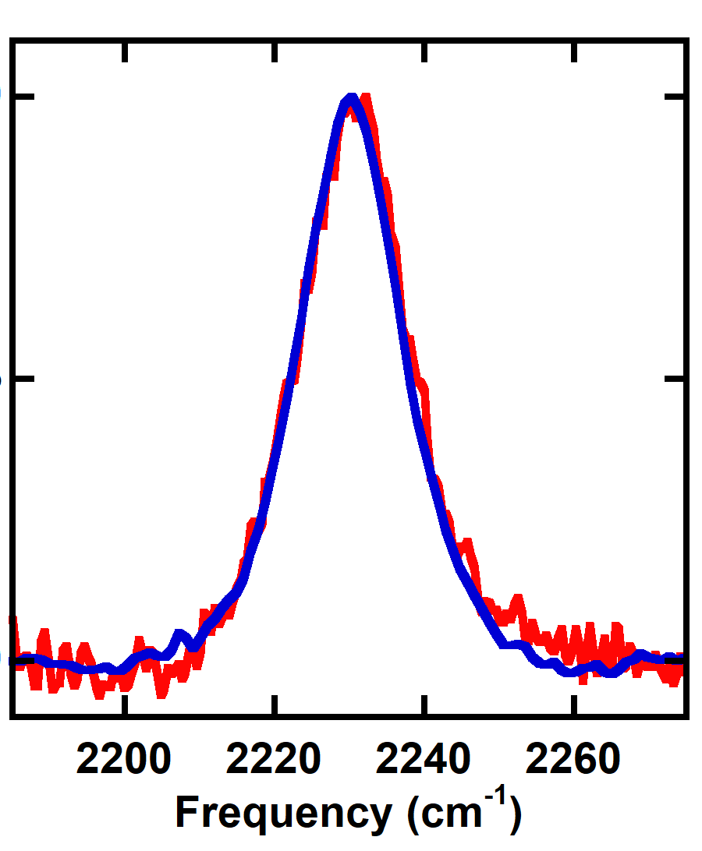
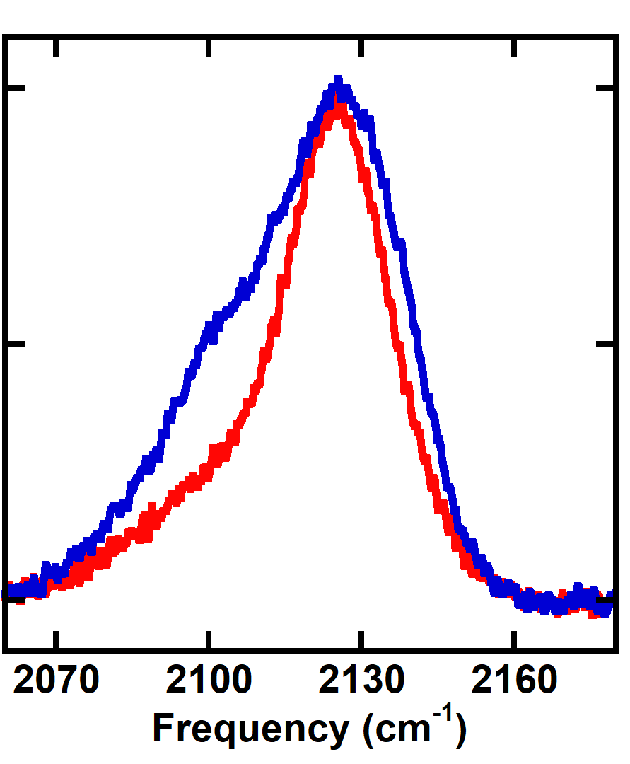
pump
Much Ado About Coupling
Enzyme active site
Tayler D. Hill
probe
signal
Vibrationally isolated → single peak
Vibrational coupling → pair of peaks
Pump frequency (cm⁻¹)
Time-dependent changes in cross peaks
T = 0 ps
T = 0.4 ps
T = 0.8 ps
Probe frequency (cm⁻¹)

