Slide 1
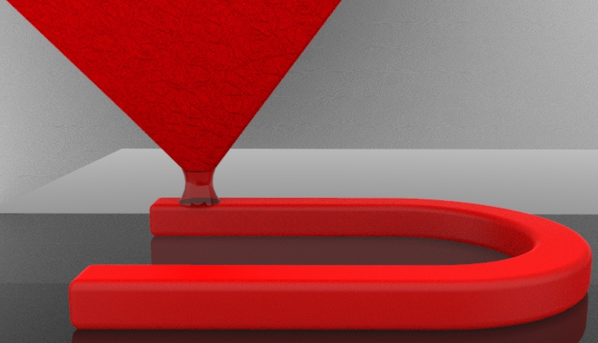
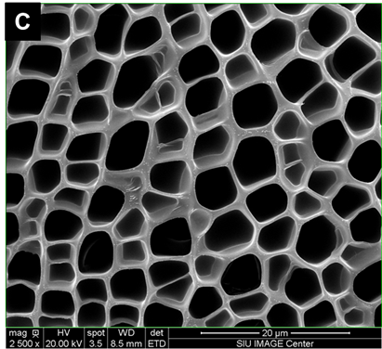
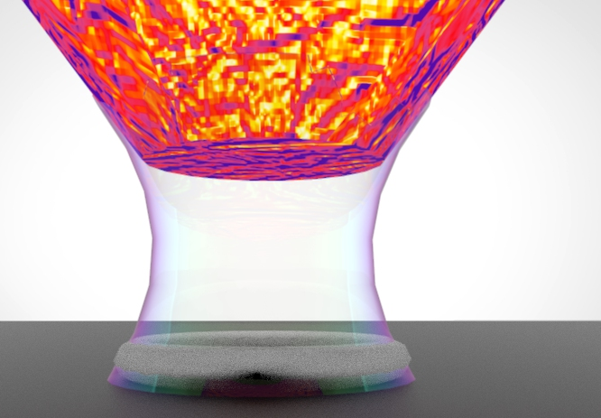
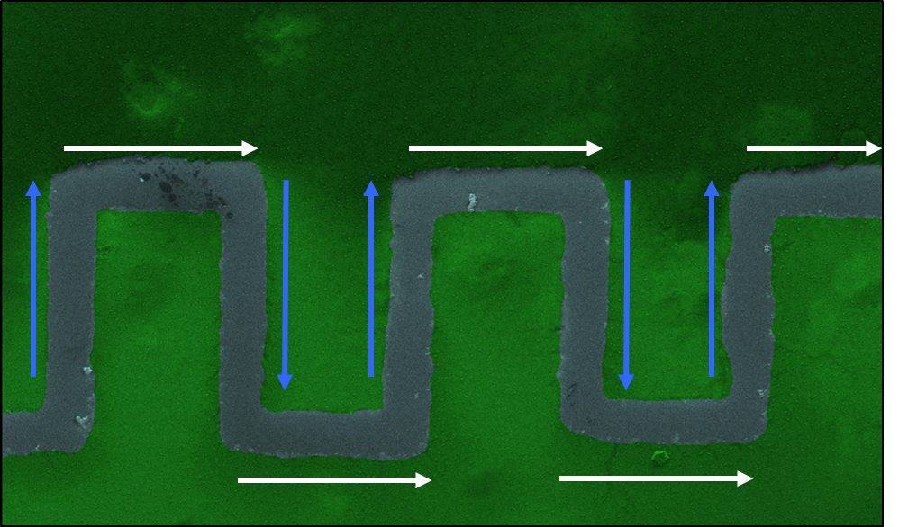
Polymer Lithography Editor for the Fabrication of Devices at Low Cost
Deposition
Solar cells
Removal
Electrical devices on flexible materials
Sustainability
Wearable sensors

