Slide 1
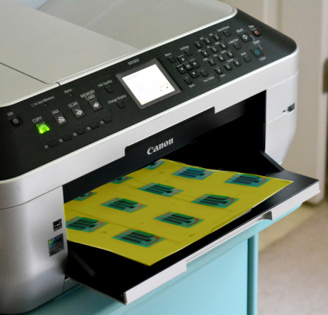
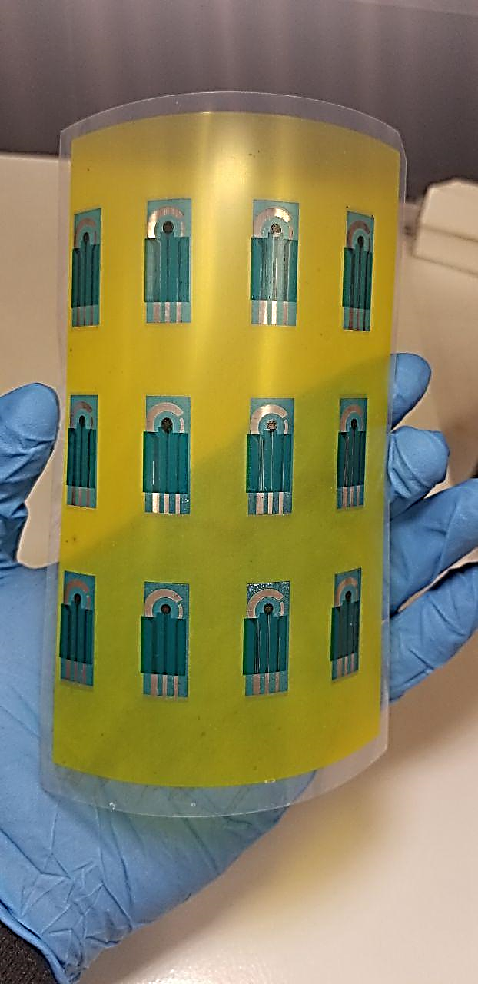
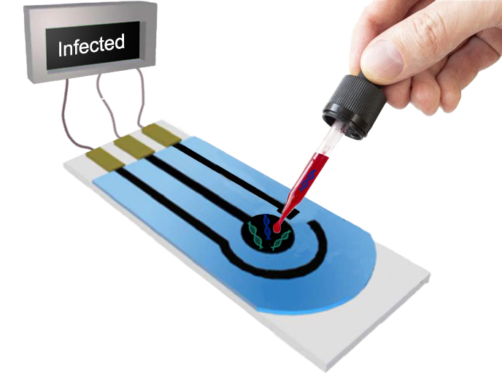
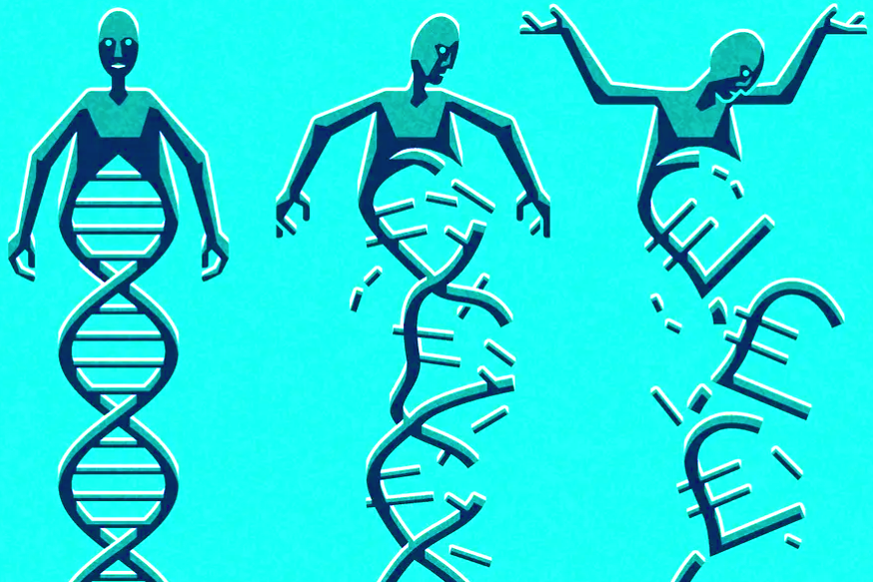
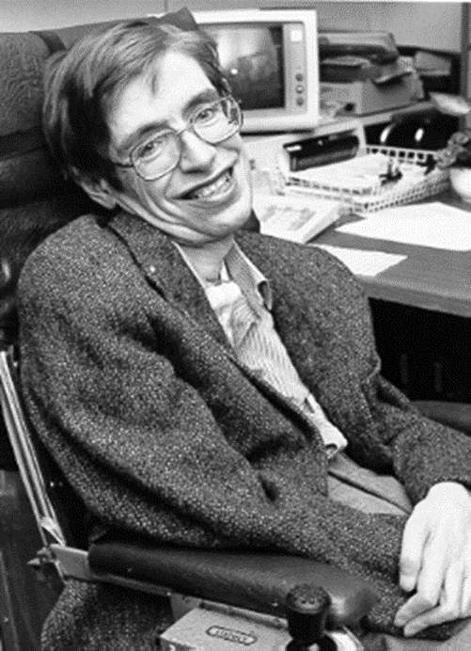
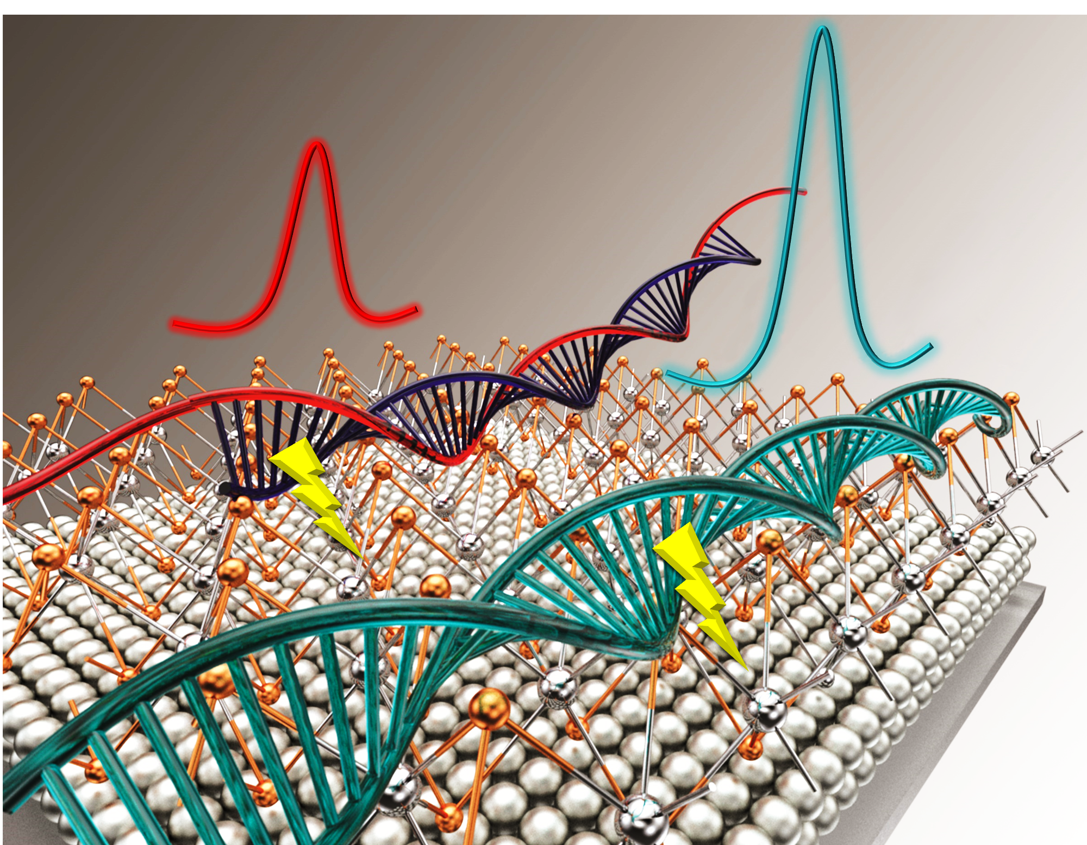
Low-cost, Simple and Fast Detection of Length Mutation
12 Sensors ∼ 12$
√
ꭙ
ꭙ
Normal DNA
(6-54)
Mutation > 50
Mutation > 200
ꭙ
Associated to more than 24 diseases
ꭙ
1 in 2,000 individuals is affected worldwide
ꭙ
Every 90 Minutes someone passes away from ALS
Theguardian.com
Narges Asefifeyzabadi, et.al, ACS Applied Materials and Interfaces, 2020, 12, 52156-52165

